Slide 1
Team “ Vortex “
Geography and History Projects

Slide 2

Our team

Slide 3
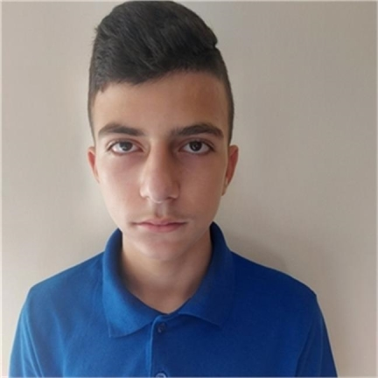
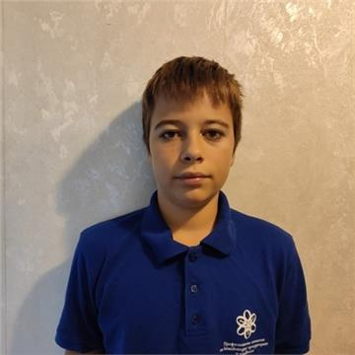
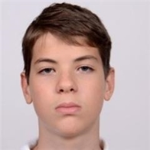
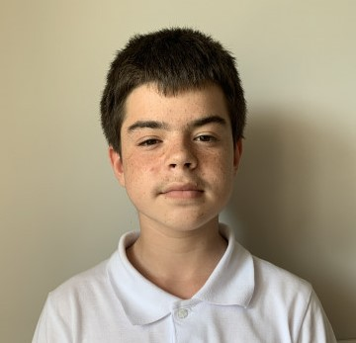
Our team
Rumen Petkov 9V
Scrum Trainer
Yoan Todorov 9V
Back-end Developer
Georgi Tabanov 9G
Designer
Ivan Dadakov 9A
Front-end Developer

Slide 4

Stages of work

Slide 5



Stages of work
1
2
3

Slide 6

Our idea

Slide 7
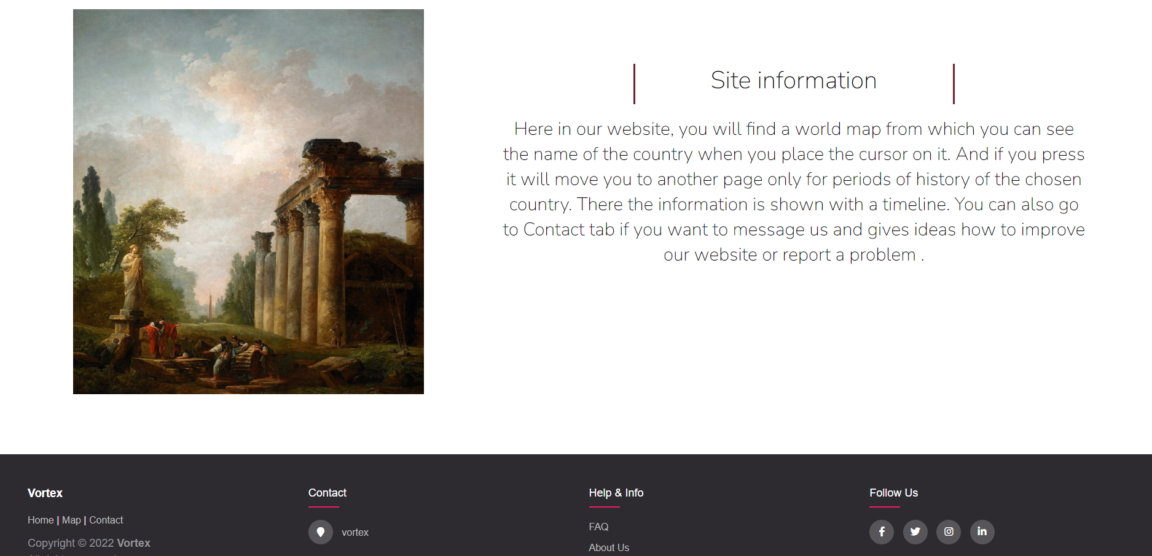
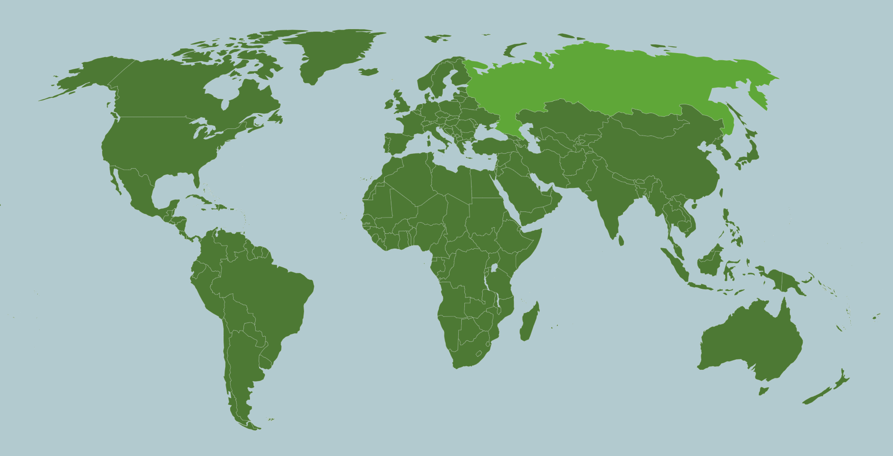
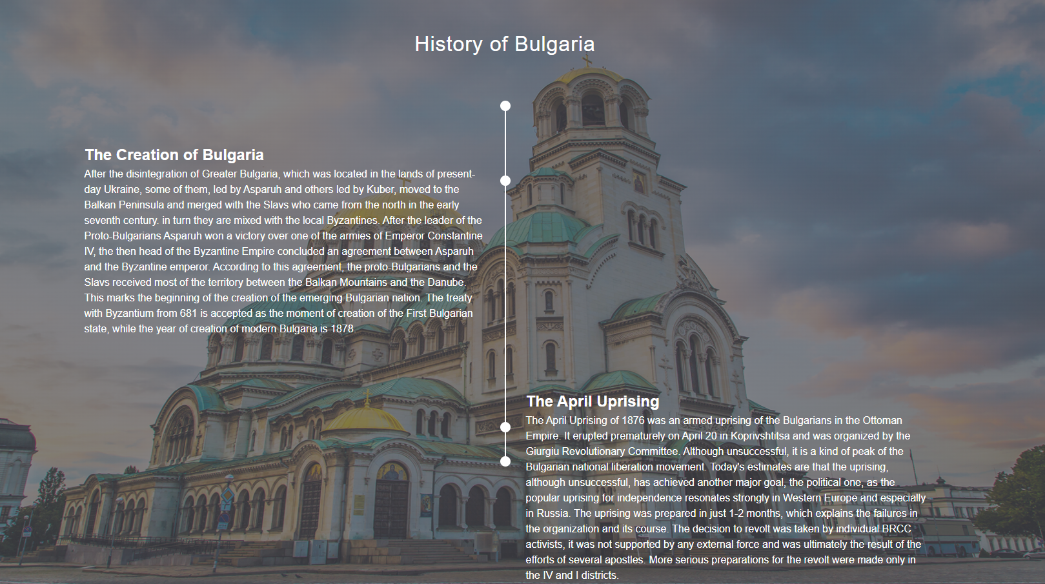
Our idea

Slide 8

Technologies

Slide 9











Technologies

Slide 10
Our website

